Slide 1
Sprint Review: SVOT & Renewals
Sprint 7
14 July – 1 Aug

Slide 2





Sprint Overview
Sprint Numbers
Sprint Links
Key Dates
Weeks
3
Sprint work Items Delivered
Sprint 7 SIT Testing
5 Aug – 8 Aug
Work Items Delivered
35
Work Items To Still Test
Sprint 7 UAT Testing
11 Aug – 22 Aug
UAT Items Addressed
4
Update ”Grainger Testing” to “Yes” to confirm the work item has delivered the functionality detailed in the Acceptance Criteria
65
Dashboard Overview
Release 2 Go Live
1 Sep
Story Points Completed
Prod Support
1 Sep - 12 Sep

Slide 3
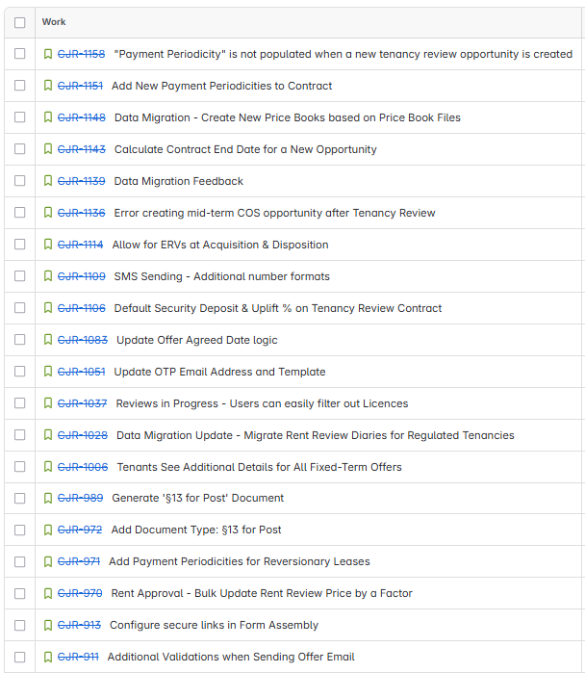
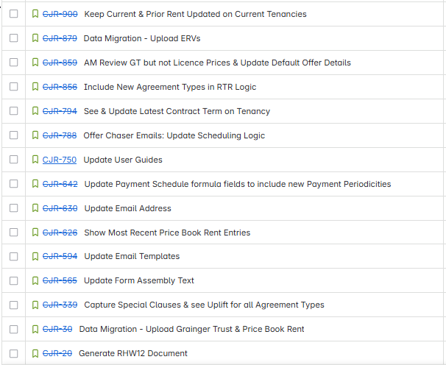
Work Items Delivered

Slide 4
Work Items Planned for Next Sprint

Slide 5
General Items
Items Carried over to next Sprint | Reasons
None
Risk | Contributing factors | Impact | Decisions taken
None
Issue | Contributing factors | Impact | Decisions taken
None
Decision | Description | Date

Slide 6

Thank You

